Slide 1
INTERNATIONAL CIVIL UNREST
KALEB KOLB
PSDS Capstone
15 January 2021

Slide 2

INTERNATIONAL CIVIL UNREST
Question to Answer
Data Acquisition
Data Carpentry
Exploratory Analysis
Modeling
Conclusions
Way Forward
Lessons Learned

Slide 3

Question to answer
What Factors Contribute to Civil Unrest (Protests and Riots)?
Economic
Educational
Health
Infrastructure
Social
Other

Slide 4

Data Acquisition
Data Locations
World Bank Open Data (data.worldbank.org)
Indicators
Armed Conflict Location & Event Data (ACLED) Project (acleddata.com)
Protest and Riot Event Data
Both Tools Aggregate Data from Various Sources

Slide 5

Data Acquisition
World Bank Data
Thousands of Indicators to Choose From
Initially Picked 394 Factors
Economic (108), Education (61), Health (67), Infrastructure (46), Social Issues (34), Other (78)
Analyzed 92 Factors, Years 2010-2019, Worldwide
Economic (17), Education (15), Health (10), Infrastructure (19), Social Issues (11), Other (20)
Data is Pulled via API Call
http://api.worldbank.org/v2/country/USA/indicator/SI.DST.10TH.10?format=json
Single call per factor, per country, returns JSON string
92 Factors x 216 Countries and Territories = 19,872 API Calls

Slide 6
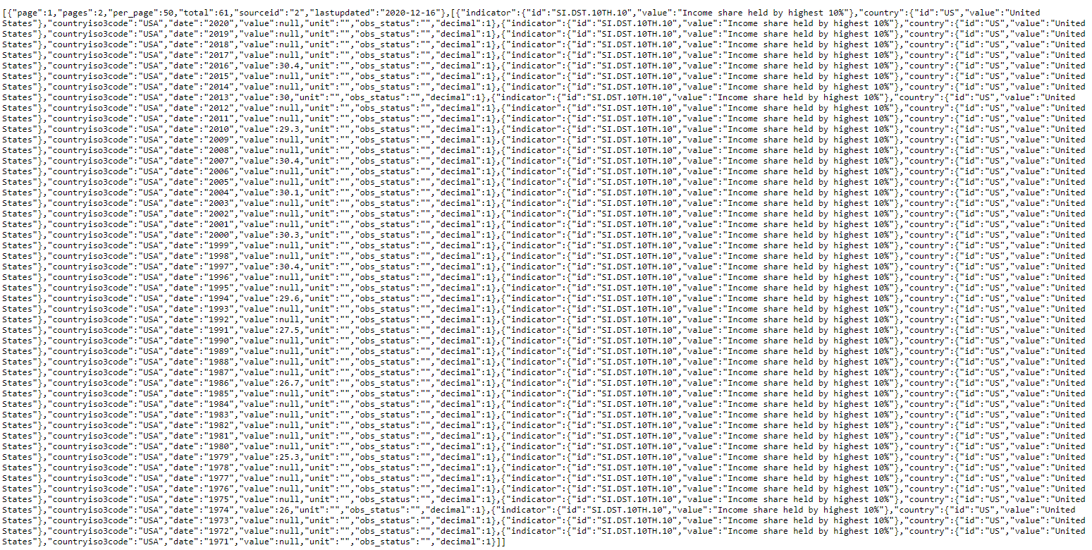
Data Acquisition
World Bank Data

Slide 7

Data Acquisition
ACLED Data
Conflict data primarily in Africa, Asia, and Latin America
Individual events are documented, primarily from news sources
Can be called via API; I exported to 10 CSV files
Used data for Protests and Riots from 2010 - 2019

Slide 8
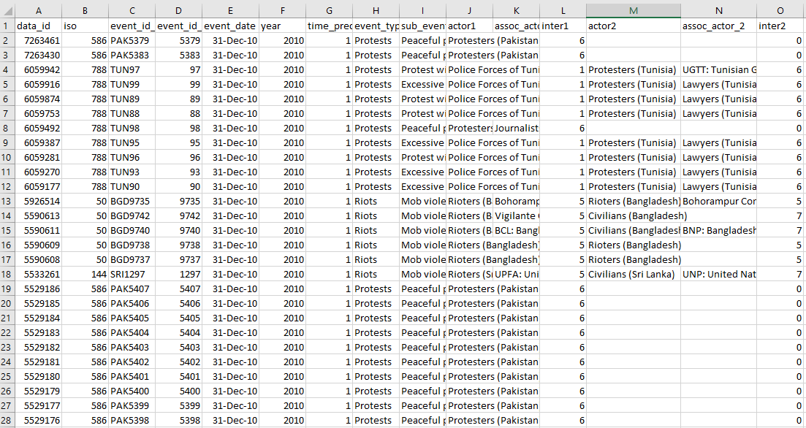
Data Acquisition
ACLED Data

Slide 9
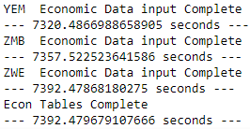
Data Acquisition
Data Pull and Storage
Used nested loop to iterate through the indicators and countries and make API calls to World Bank dataset
Pulled ACLED data in from CSV files
Saved everything to PostgreSQL Database in 93 tables
~30 seconds per country per category (Econ, Health, Social, etc…)
~10 hours to populate database

Slide 10
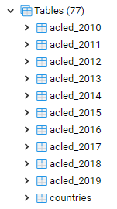
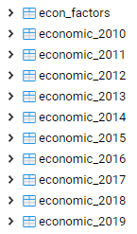
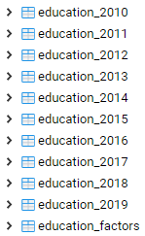
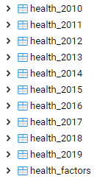
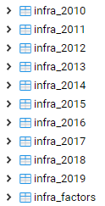
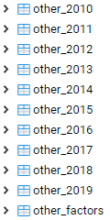
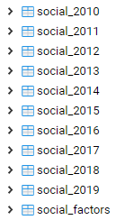
Data Acquisition
PostgreSQL – unrestdatabase
93 Tables
acled_201X, countries, indicator_factors, indicator_201X,

Slide 11
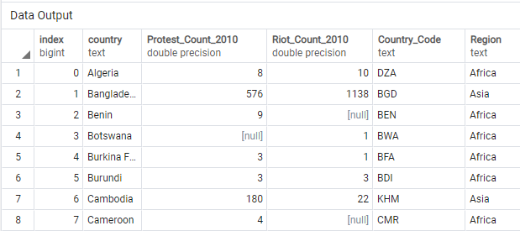
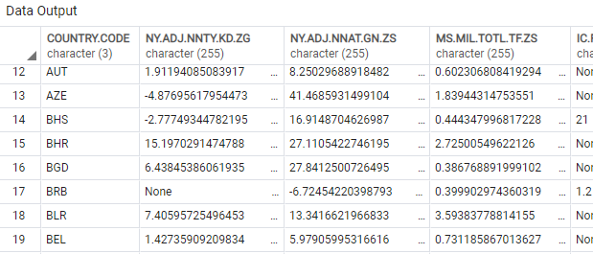
Data Acquisition
Table Examples
acled_2010 economic_2010

Slide 12
Data Carpentry
Data Initially looked to be in fairly good shape upon retrieval
Fairly well-structured and when looking at it from a macro scale seemed complete enough to continue
Didn’t think I would have to do much more to the data
And then I started exploratory data analysis…

Slide 13
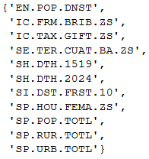
Exploratory Analysis
Wanted to find indicators that correlated with # of Protests and # of Riots
Knew a negative correlation is as good as a positive
Looped through indicators and years to find correlations with absolute value > 0.6 (somewhat arbitrary)
Saved to master set to de-dupe

Slide 14
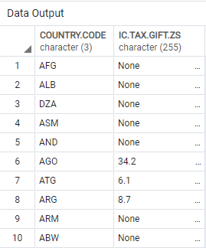
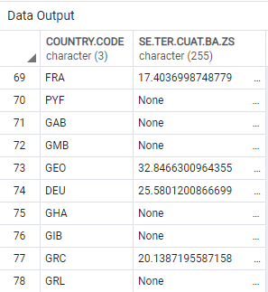
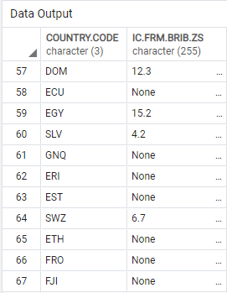
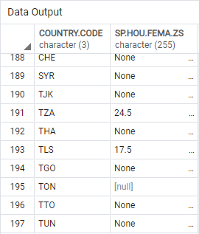
Exploratory Analysis

Slide 15
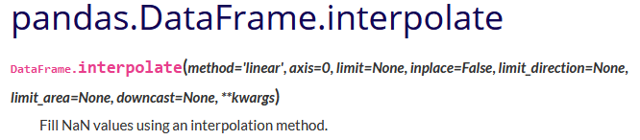
Exploratory Analysis
Needed a way to fill in ‘None’ values
Pandas has function – Interpolate
At this point data is in table by year, so back to carpentry

Slide 16
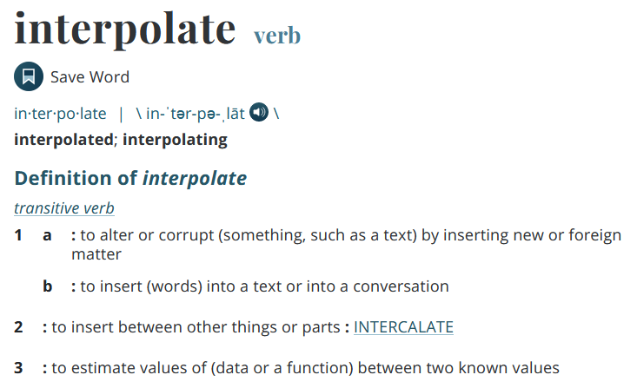
Data Carpentry
Current table format was not conducive to interpolation
Joins are expensive
SQL → DF → SQL

Slide 17
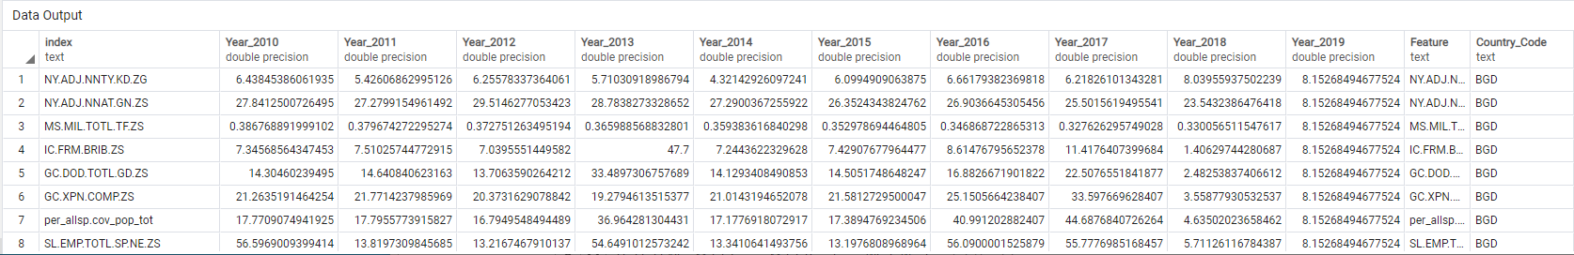
Data Carpentry
Table Example
BGD_2010

Slide 18
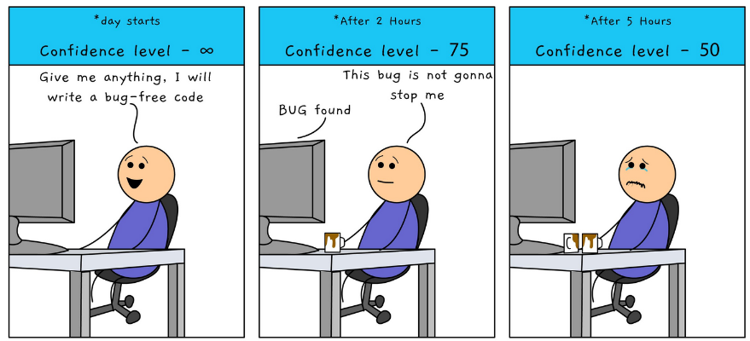
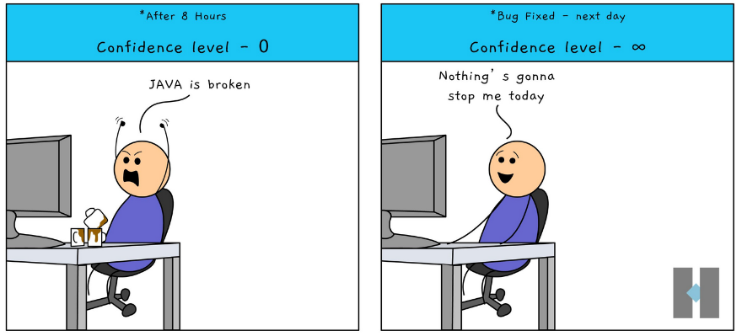
Exploratory Analysis
After 2500 lines of code, I'm back

Slide 19
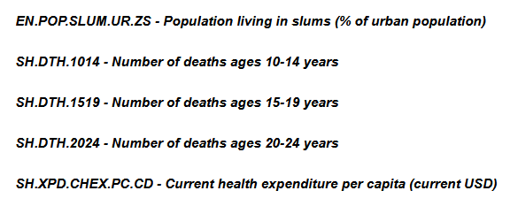
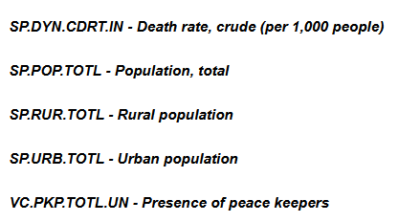
Exploratory Analysis
Looped through indicators and years to find correlations with absolute value > 0.75 (still somewhat arbitrary)
Saved to master set to de-dupe

Slide 20
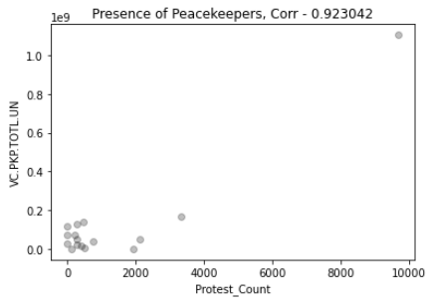
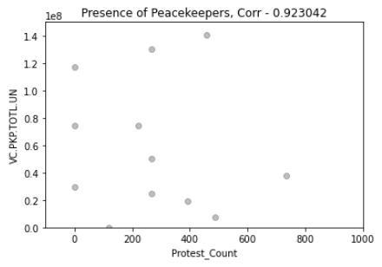
Exploratory Analysis
Looped through indicators and years to find correlations with absolute value > 0.75 (still somewhat arbitrary)
Saved to master set to de-dupe

Slide 21
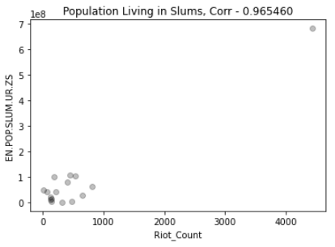
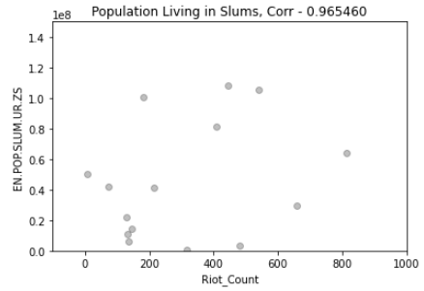
Exploratory Analysis
Looped through indicators and years to find correlations with absolute value > 0.75 (still somewhat arbitrary)
Saved to master set to de-dupe

Slide 22
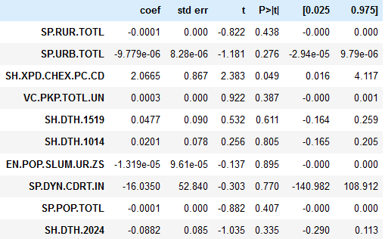
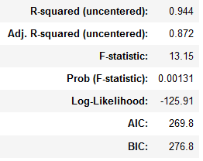
Statistical modeling
Regression – Ordinary Least Squares (OLS)
Dep. Variable: Protest_Count
Ind. Variables: 10 Indicators with correlation Value > 0.85
statsmodel.api package

Slide 23
Way forward
Incorporate More Statistical Modeling
Additional Regression, ANOVA, MANOVA
Machine Learning
Find way to more reliably interpolate
Find better way to compare countries
Region, Quality Index, Population, etc…
Build Dashboard
Sentiment Analysis – Triggers

Slide 24
Lessons learned
Start with a smaller data set
Be flexible
Put everything in a database
API vs. CSV?
Play to your Strengths

